Slide 1
💡
LAMP BASED
Smart Home Hub

Slide 2
Under sufficient lighting conditions, it is unnecessary to have overly strong lighting, which can lead to energy waste. Some desk lamps cannot adjust their brightness, causing discomfort to the eyes due to environmental changes during work.
Getting up in the middle of the night and navigating in the dark is unsafe, necessitating the automatic activation of a night light.
Many people spend prolonged periods sitting at their desks, which negatively impacts their physical health. We hope to provide some reminders.
We hope to have an integrated system that can visually display indoor temperature and humidity and provide suggestions for adjusting the indoor temperature.
light intensity control
PROBLEM
&
SOLUTION
Night mode
Mode recognition and sedentary reminder
Environment information showed on webpage

Slide 3
This is a smart desk lamp based on AloT.
Besides lighting, it also implements additional functions.
Such as work status monitoring, sedentary reminder.
The Raspberry Pi as a core controls the sensors,
include PIR, camera, photosensitive sensor, etc.
Some of the data will facilitate machine learning
Lamp Based
Smart Home Hub
Introduction

Slide 4
1
IoT
Chapter I
2
AI
Chapter II
CONTENTS
3
Webpage
Chapter III
4
Functions
Chapter IV

Slide 5
1
HARDWARE

Slide 6
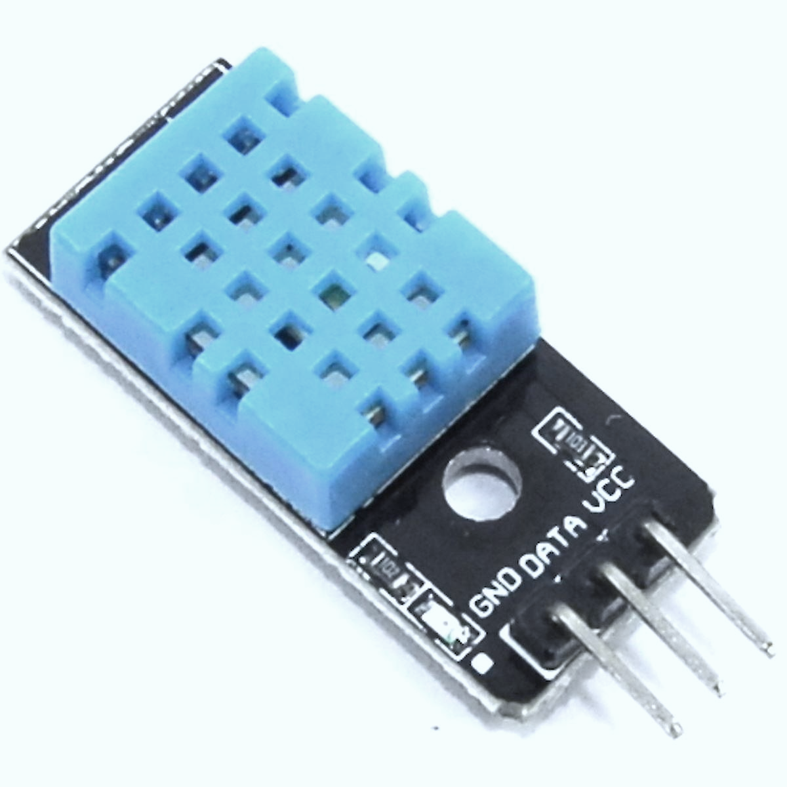
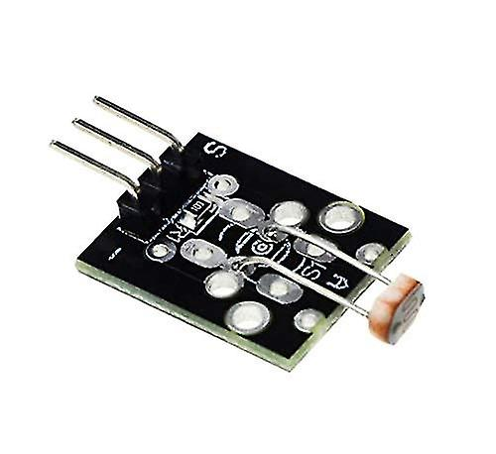
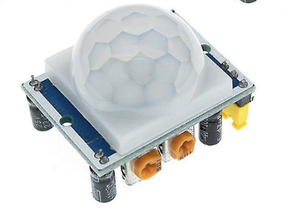
Sensors
Photoresistor
PIR sensor
Temp and humidity

Slide 7
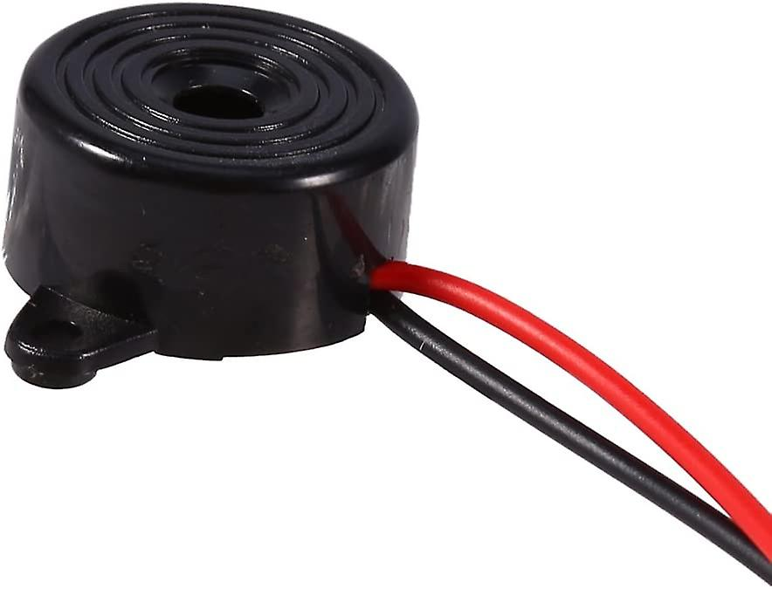
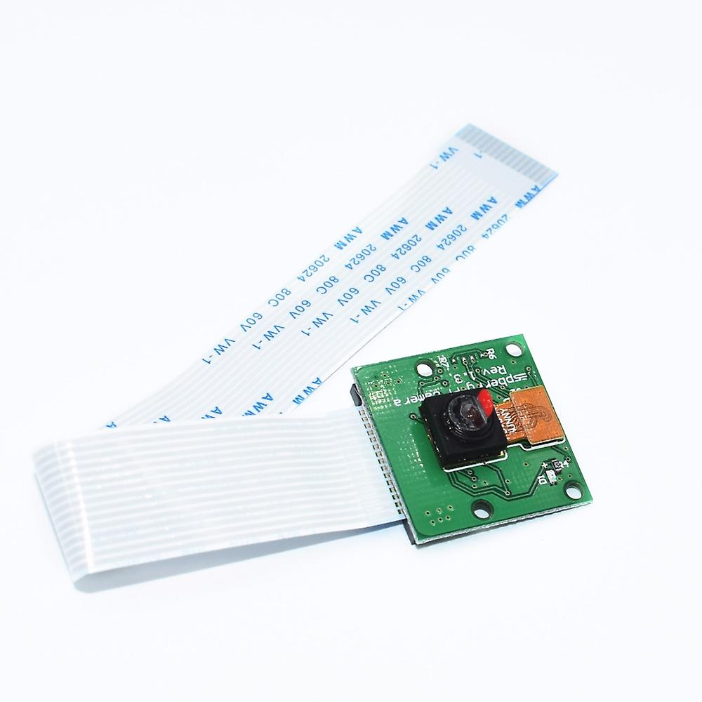
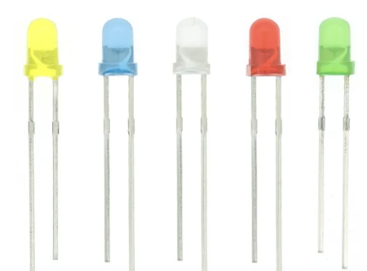
Other hardware
Camera
LED
Buzzer

Slide 8
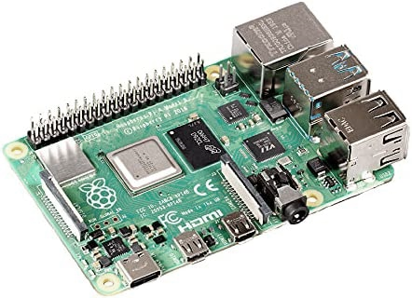
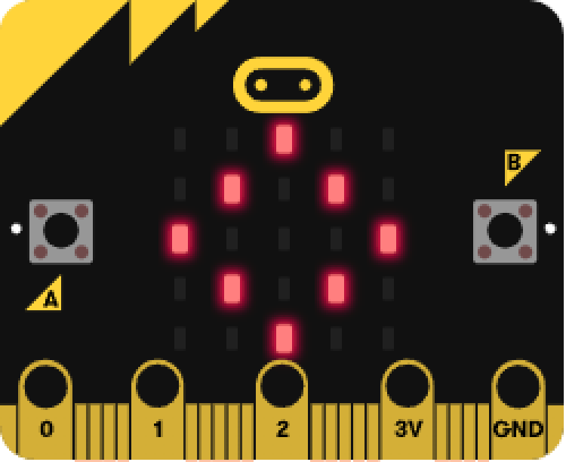
Raspberry Pi
As the most important part of the system,
it collects information and outputs commands.
It also interacts with web pages via http and MQTT.
Micro:bit
It controls the light on/off through serial communication.

Slide 9
2
AI

Slide 10
Dataset
Train
Reading
None
Val
Reading
Computer
Computer
None
We recorded videos of people in three different modes: using a computer, reading, and no people. Then, we saved these videos frame by frame as a machine learning database.

Slide 11
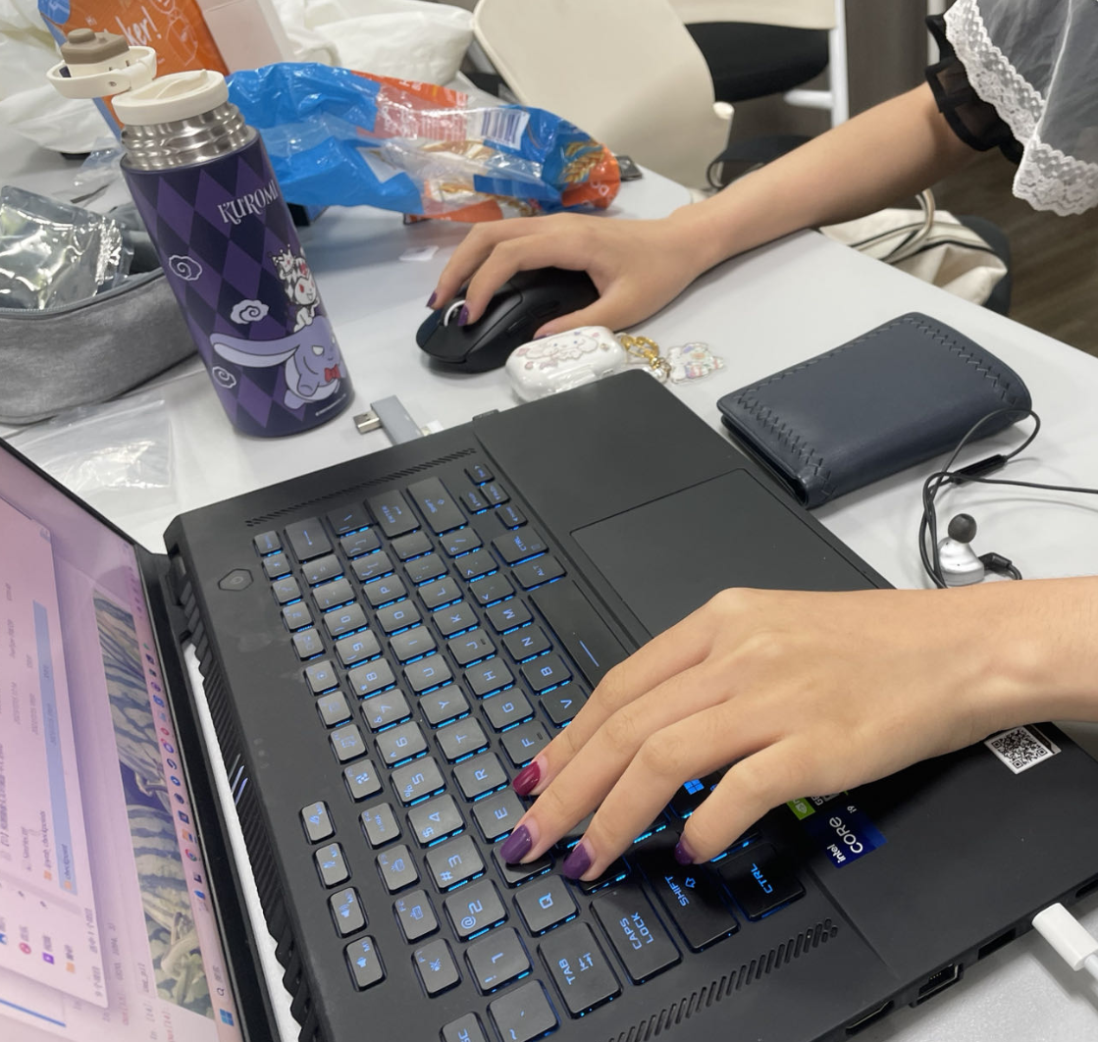
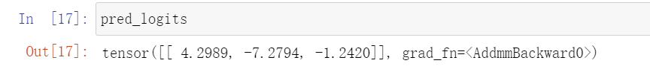
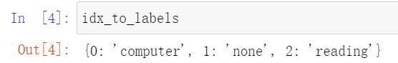
We used a pre-trained ResNet model for transfer learning to recognize the actions of users captured by the camera, thereby determining their working patterns.
Example

Slide 12
3
Webpage

Slide 13




项目标题
If you want , you can delete the text .
Web page
On the web side, we are based on the Flutter framework and transfer information with hardware over HTTP and MQTT protocols.
项目标题
If you want , you can delete the text .
HTTP
MQTT

Slide 14
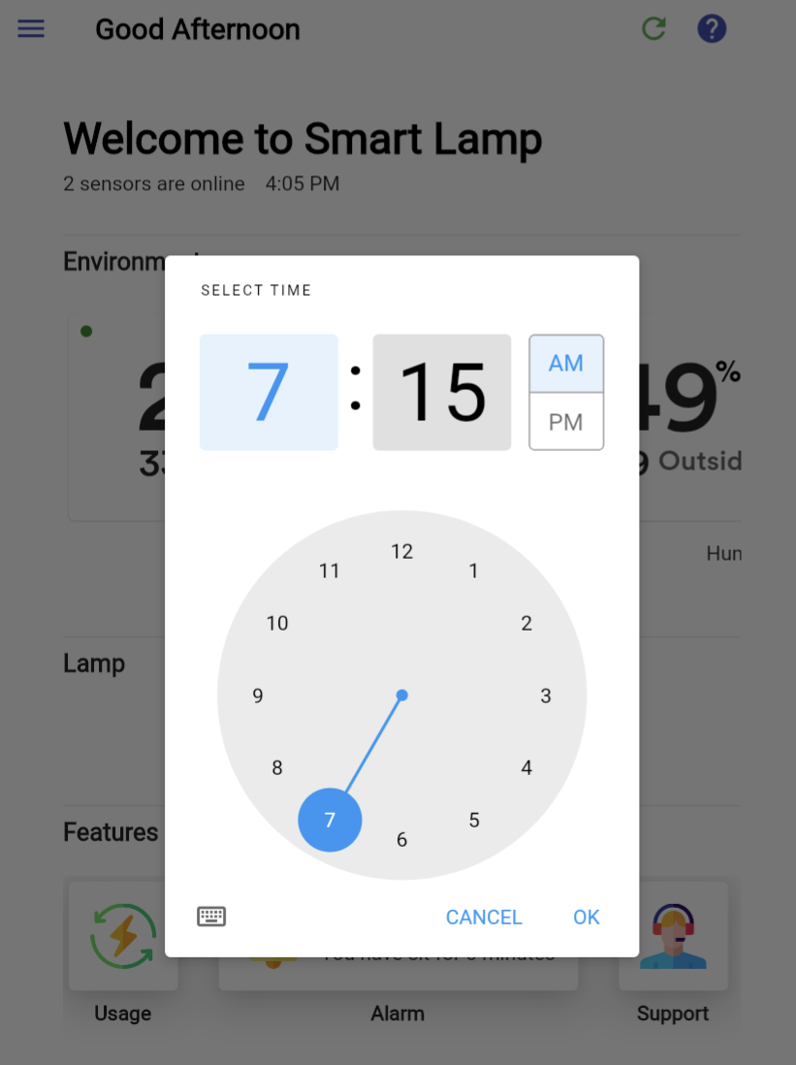
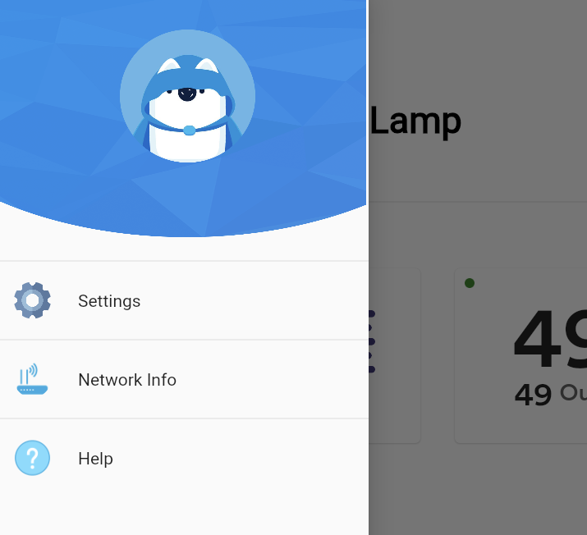
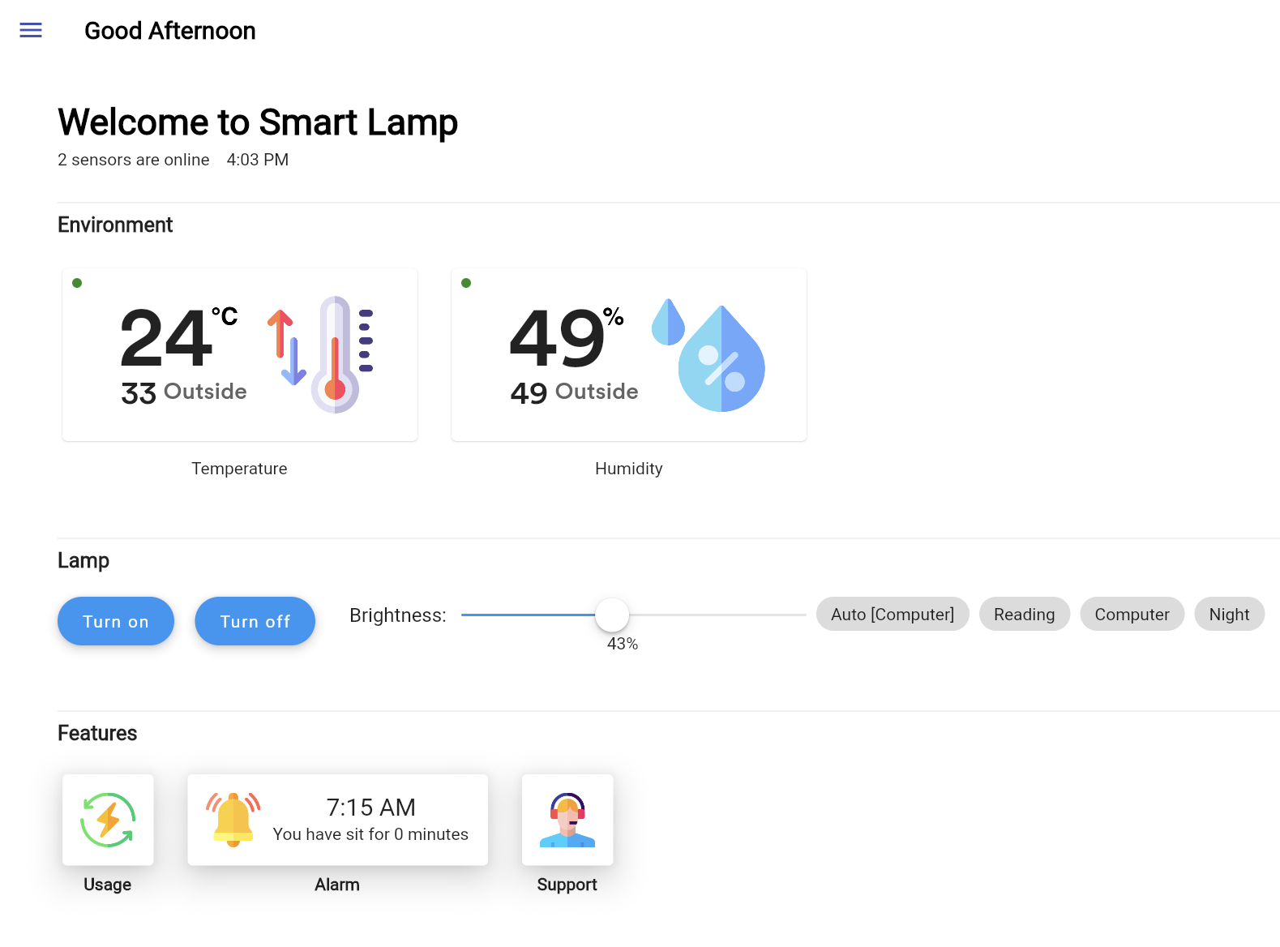
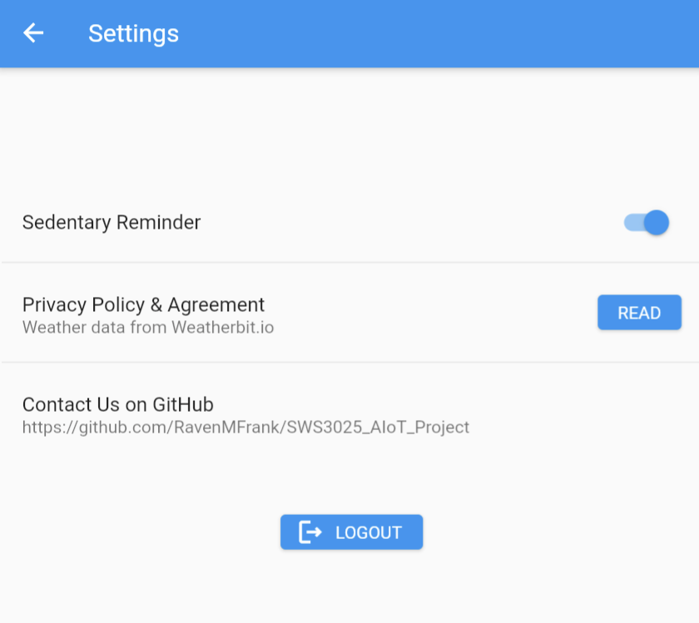
Web page
Drawer
Home page

Slide 15
Web page
Settings page
Time Selecter

Slide 16
4
FUNCTIONS

Slide 17
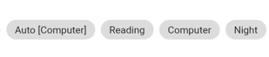
FUNCTIONS
[Auto]Mode Recognition:
Under the "Auto" state, the camera captures the scene for recognition and displays the result on the webpage. It shows "Reading" or "Computer“ modes.
Additionally, based on different modes, different LED light intensities are used.
If the user is not within the frame for a while, the system switches to "Manual" mode, and the brightness remains constant until the user returns.
[Manual]Mode choose:
Users can manually select the operating mode on the webpage, and the Raspberry Pi will control the LED to output different light intensities accordingly.

Slide 18
FUNCTIONS
Night mode:
In Night mode, the LED is initially in the off state.
When the PIR sensor detects someone passing by, the LED will turn on with a dim light for around 10 senconds, providing a night light for users in dark environments.

Slide 19
FUNCTIONS
Sedentary reminder & Alarm:
When the system in work modes (reading or computer) , it will calculate the sit time. As the sit time reaches a certain number, the buzzer would work.
Users could also set alarm in the webpage, and the buzzer would ring on time.

Slide 20
FUNCTIONS
light intensity control:
Auto: In those work modes, the current light intensity measured by the photoresistor sensor is incorporated into the light intensity function, which is used to adjust the brightness of LEDs.
Manual: Users could use the webpage to turn on/off the LEDs. Also, the brightness of LEDs could also be controlled by the webpage.

Slide 21
FUNCTIONS
Environment:
This part shows the current indoor and outdoor temperature and humidity.

Slide 22
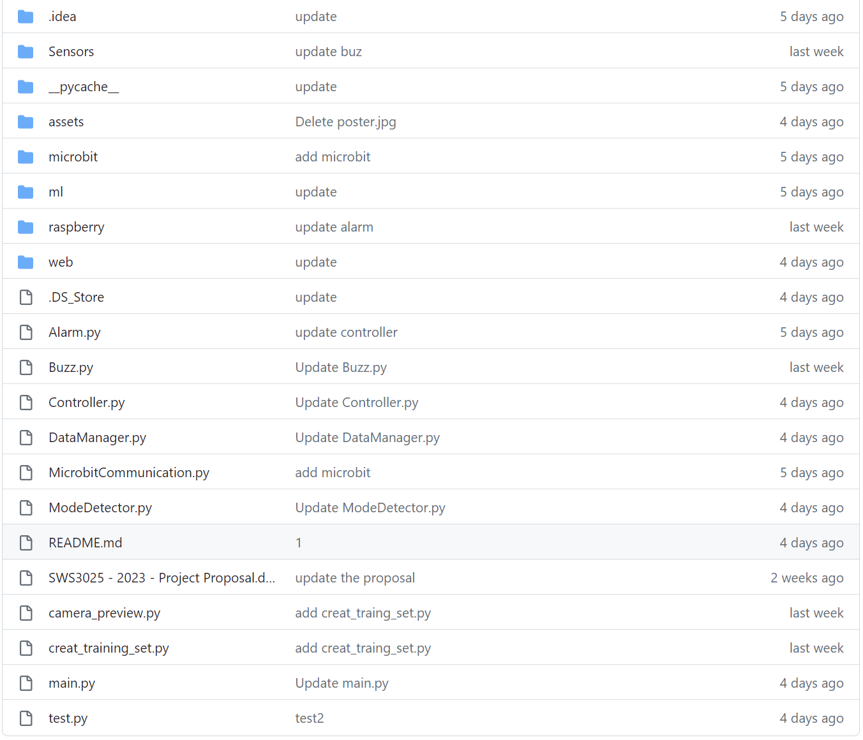
GitHub:https://github.com/RavenMFrank/SWS3025_AIoT_Project

Slide 23
SWS3025-04
Jiuen Feng
Yiran Mao
Chenxu Tian
Siyi Zhou
THANKS
FOR YOUR LISTENING

